Slide 1
Avoiding Wordiness

Slide 2
Wordiness
If your writing is “wordy,” that means it contains too many unnecessary words.

Slide 3
Concision
The opposite of wordy is “concise.”

Slide 4
Concise Writing
Concise writing uses enough words to get the point across, but not so many that the point gets lost.

Slide 5
Imagine that your idea is a delicious basket of fries.

Slide 6
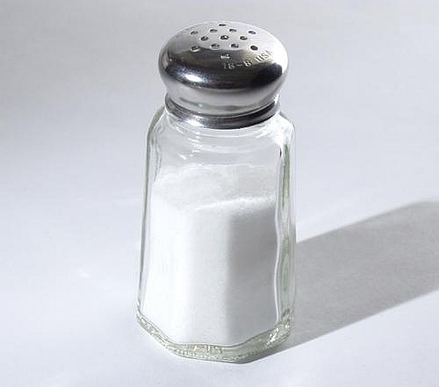
Your words are the salt you use to make your idea fries awesome and delicious.

Slide 7
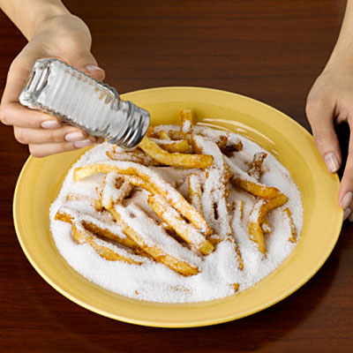
But if you use too much word salt, I can’t even taste your idea fries anymore!
Gross!

Slide 8
Redundancy
Remember redundancy? It’s a form of wordiness.

Slide 9
Example 1:
The reason why he went to Douglas College was because it was inexpensive in price.

Slide 10
Example 1:
The reason why he went to Douglas College was because it was inexpensive in price.

Slide 11
Example 1:
reason, why, because -- all refer to the same idea
inexpensive, price -- “inexpensive” already includes the idea of “price”

Slide 12
Example 1:
He went to Douglas College because it was inexpensive.

Slide 13
Example 2:
Despite the fact that she was feeling ill, she came to the conclusion that she would go to work.

Slide 14
Example 2:
Despite the fact that she was feeling ill, she came to the conclusion that she would go to work.

Slide 15
Example 2:
Despite the fact that -- a long way of saying “despite”
came to the conclusion that -- a long way of saying “decided”

Slide 16
Example 2:
Despite feeling ill, she decided she would go to work.

Slide 17
Example 3:
In my opinion, I think the study of Sociology is very fascinating.

Slide 18
Example 3:
In my opinion, I think the study of Sociology is very fascinating.

Slide 19
Example 3:
In my opinion, I think -- same idea
study, Sociology -- “sociology” already includes the idea of “study”
very fascinating -- “fascinating” means very interesting, so “very” is already included in the idea

Slide 20
Example 3:
In my opinion, I think, fascinating -- “fascinating” is a judgement, so it is clear this is an opinion without directly stating “in my opinion” or “I think”

Slide 21
Example 3:
Sociology is fascinating.

Slide 22
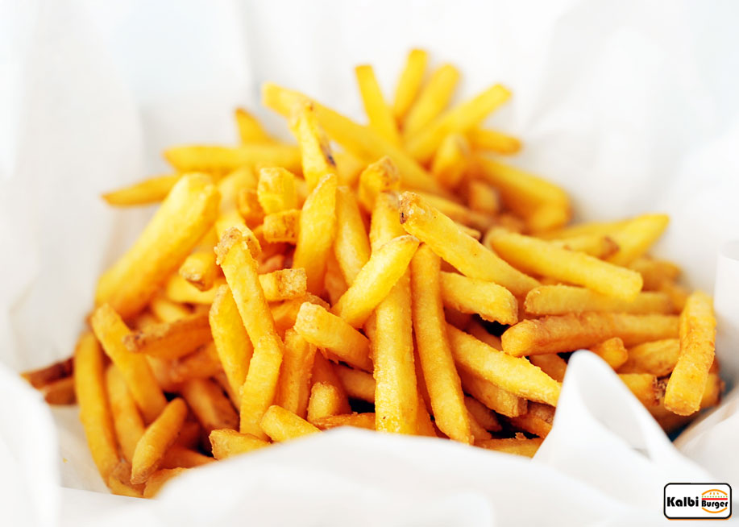
Now you try!

