Slide 1
The Magical Semicolon
;
Mrs. Castor’s favorite punctuation mark.

Slide 2
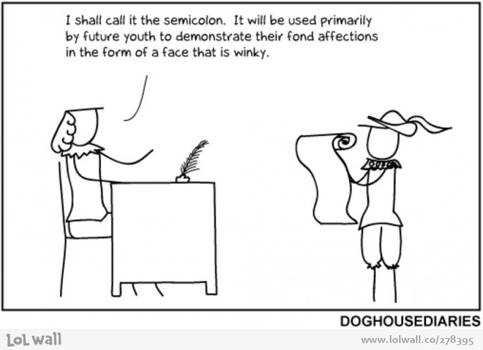

Slide 3
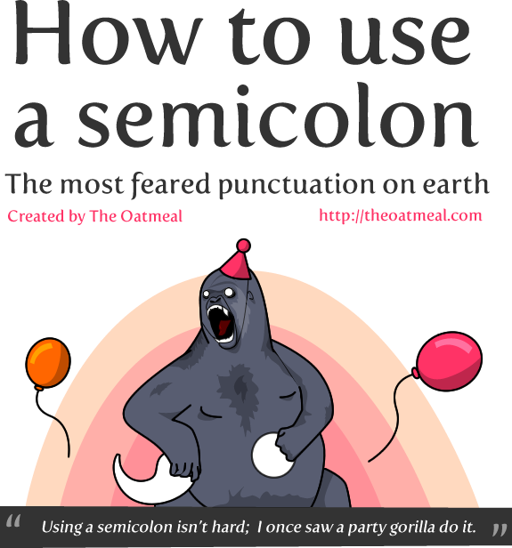

Slide 6
Write this down:
When do I use a semicolon?
The main use of a semicolon is to connect two complete sentences.
Almost anywhere you can use a comma + FANBOYS to connect two sentences, you can use a semicolon instead!

Slide 7
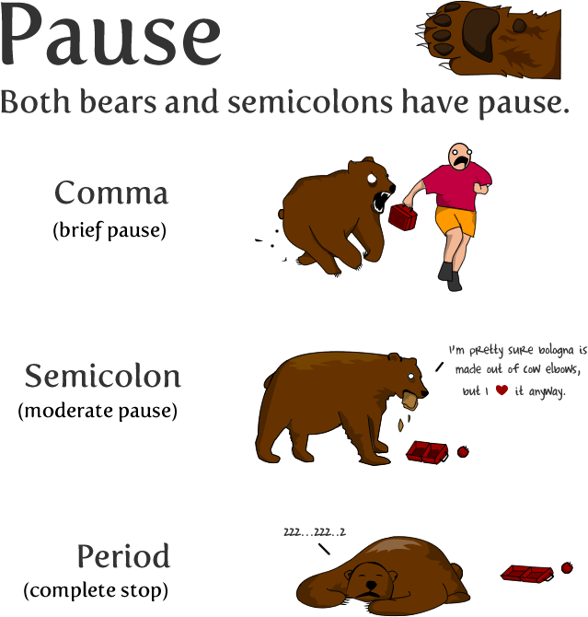

Slide 8
Write this down:
When do I use a semicolon?
Use a semicolon to put a pause between two sentences that is longer than a comma but shorter than a period.
Period > Semicolon > Comma

Slide 10
Write this down:
When do I use a semicolon?
Use a semicolon to connect sentences when the ideas in the sentences are related to each other.
RIGHT:
I gnaw on old tires; it strengthens my jaw so I’ll be better conditioned for bear combat.

Slide 11
Write this down:
DON’T USE A SEMICOLON WHEN:
Two sentences aren’t related to each other.
WRONG:
I fought the bear and won; I never kiss plague rats on the mouth.

Slide 13
Write this down:
Don’t ever use a semicolon with a FANBOYS.
WRONG:
My aunt’s hairy knuckles are magnificent; but I have no desire to stroke them.

Slide 15
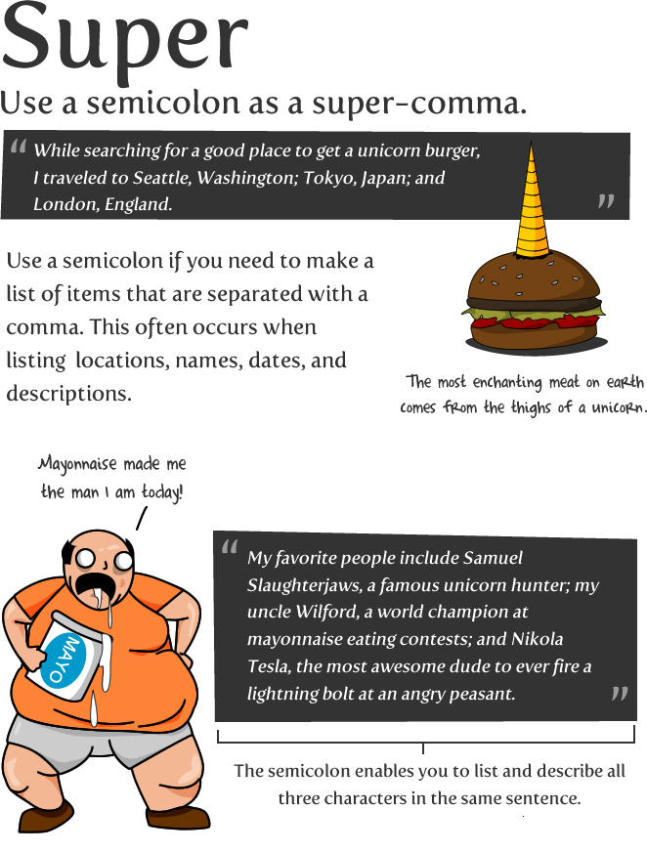

Slide 16
Write this down:
USING A SEMICOLON AS A SUPERCOMMA:
Use a semicolon to separate a list of items that include commas (like dates or locations)
RIGHT:
While searching for a good place to get a unicorn burger, I traveled to Seattle, Washington; Tokyo, Japan; and London, England.

Slide 17
